Slide 1

Biological Modeling
A Short Tour
Phillip Compeau
Notes:
front_cover

Slide 2
Biological Modeling
A Short Tour
Phillip Compeau
Notes:
front_cover_9_by_6

Slide 3

Join us for a tour of biological modeling
Biological Modeling: A Short Tour offers readers a deep but concise exploration of topics in modeling biological systems at multiple scales of resolution, from the molecular to the cellular.
Each chapter asks a single biological question, from why zebras have stripes, to how bacteria explore their world intelligently, to why the SARS-CoV-2 spike protein was so effective at binding to human cells. It then introduces topics in biological modeling needed to answer these questions.
The book website (biologicalmodeling.org) provides a free online course containing dozens of interactive tutorials allowing readers to build and explore the models introduced in this book. The course was produced because of the hard work of talented students at Carnegie Mellon University, and these students appear as chapter co-authors.
Phillip Compeau, Ph.D. is an Associate (Teaching) Professor in the Computational Biology Department at Carnegie Mellon University. He is the founder of scalable online education projects that have reached over a million learners worldwide.
ISBN
Notes:
back_cover

Slide 4
Compeau
Biological Modeling A Short Tour
Philomath Press
Notes:
spine

Slide 5
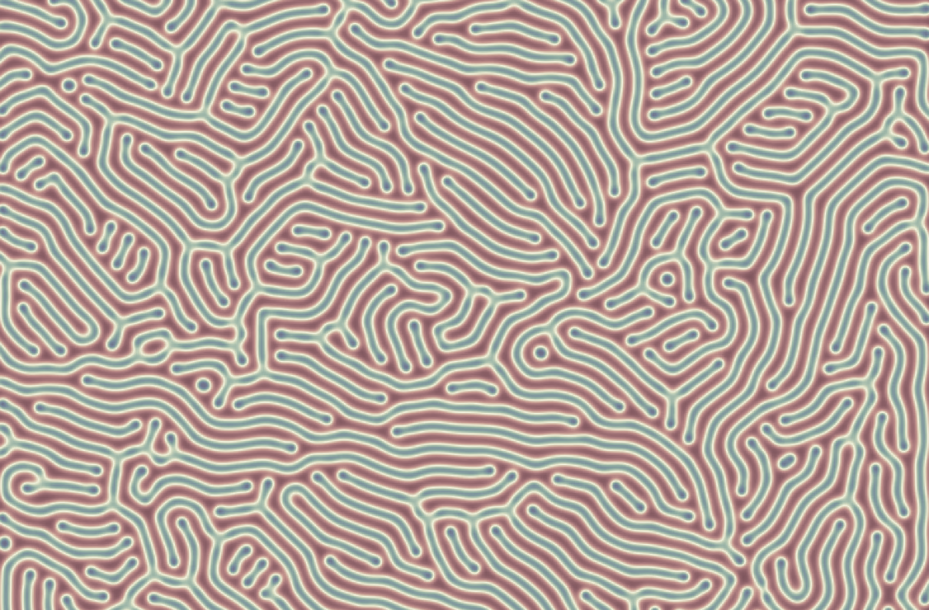
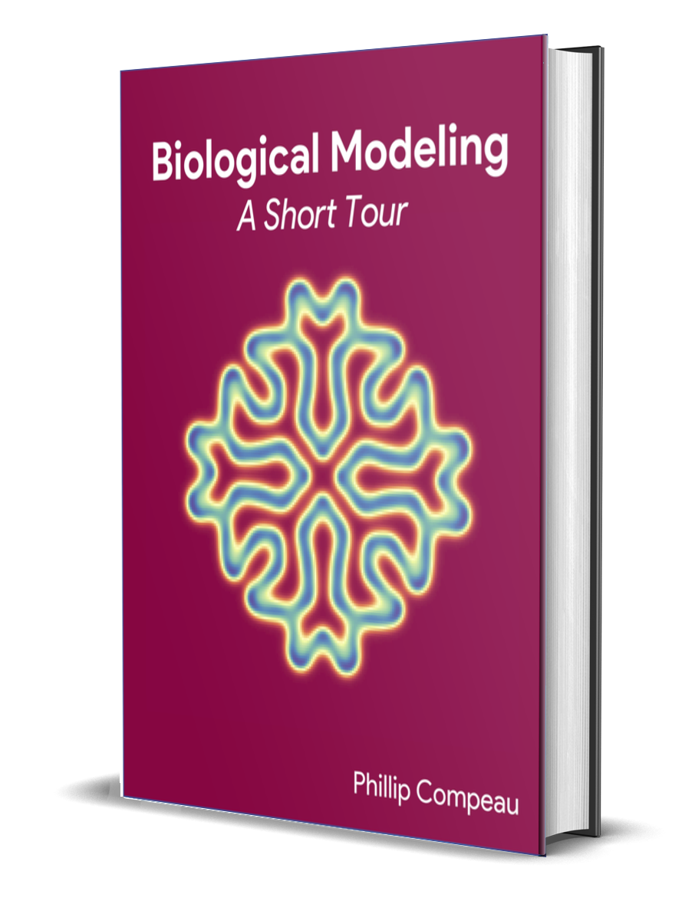
Notes:
kickstarter

Slide 6


Notes:
laptop

Slide 7
B
A
B
B
B
A
A
A
A
B
B
A
B
A
Notes:
reaction-diffusion_three_reactions_before

Slide 8
B
A
B
B
B
A
A
B
B
A
B
A
B
A
Notes:
reaction-diffusion_three_reactions_after

Slide 9
0 | 0 | 0 | 0 | 0
0 | 0 | 0 | 0 | 0
0 | 0 | 1 | 0 | 0
0 | 0 | 0 | 0 | 0
0 | 0 | 0 | 0 | 0
Notes:
initial_A_concentration

Slide 10
0 | 0 | 0 | 0 | 0
0 | .05 | .2 | .05 | 0
0 | .2 | 0 | .2 | 0
0 | .05 | .2 | .05 | 0
0 | 0 | 0 | 0 | 0
Notes:
A_concentration_one_time_step

Slide 11
? | ? | ? | ? | ?
? | .08 | .04 | .08 | ?
? | .04 | .17 | .04 | ?
? | .08 | .04 | .08 | ?
? | ? | ? | ? | ?
Notes:
A_concentration_two_time_steps_partial

Slide 12
.0025 | .02 | .045 | .02 | .0025
.02 | .08 | .04 | .08 | .02
.045 | .04 | .17 | .04 | .045
.02 | .08 | .04 | .08 | .02
.0025 | .02 | .045 | .02 | .0025
Notes:
A_concentration_two_time_steps_complete

Slide 13
0 | 0 | 0 | 0 | 0
0 | .01 | .04 | .01 | 0
0 | .04 | .8 | .04 | 0
0 | .01 | .04 | .01 | 0
0 | 0 | 0 | 0 | 0
Notes:
A_concentration_slower_diffusion

Slide 14
0, 0 | 0, 0 | 0, 0 | 0, 0 | 0, 0
0, 0 | 0, 0 | 0, 0 | 0, 0 | 0, 0
0, 0 | 0, 0 | 1,1 | 0, 0 | 0, 0
0, 0 | 0, 0 | 0, 0 | 0, 0 | 0, 0
0, 0 | 0, 0 | 0, 0 | 0, 0 | 0, 0

Slide 15
0, 0 | 0, 0 | 0, 0 | 0, 0 | 0, 0
0, 0 | .01, .005 | .04,.02 | .01, .005 | 0, 0
0, 0 | .04,.02 | .8, .9 | .04,.02 | 0, 0
0, 0 | .01, .005 | .04,.02 | .01, .005 | 0, 0
0, 0 | 0, 0 | 0, 0 | 0, 0 | 0, 0
Notes:
two_particle_concentration_diffusion

Slide 16
Translation
Protein
mRNA
(Auto)regulation
Transcription
Gene
DNA
Notes:
autoregulation_example

Slide 17
Cell 1
Cell 2
X
Y
X
Y
−
+
+
Notes:
two_cells

Slide 18
X
Y
Z
Notes:
feed-forward_loop

Slide 19
+
+
−
X
Y
Z
Notes:
type-1_incoherent_feed-forward_loop

Slide 20
−
X
Y
−
−
Z
Notes:
repressilator

Slide 21
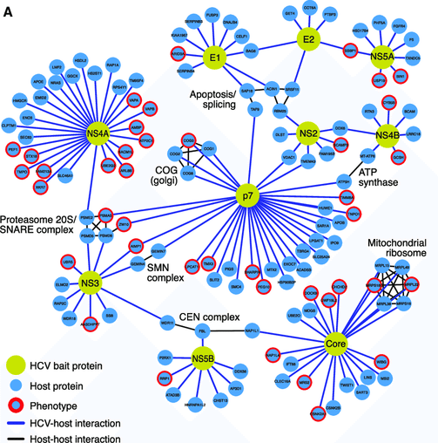

Slide 22
L
3) Response: changed rotation direction
1) Stimulus: ligand
L
L
L
L
Extracellular Space
Receptor
Cellular membrane
Chesson P.. Mechanisms of maintenance of species diversity. Annu Rev Ecol Evol Syst 31: 343-366 https://journals.plos.org/ploscompbiol/article?id=10.1371/journal.pcbi.1008010
Cytoplasm
CW rotation
2) Signaling Events

Slide 23
L
L
L
L
L
Receptor
Chesson P.. Mechanisms of maintenance of species diversity. Annu Rev Ecol Evol Syst 31: 343-366 https://journals.plos.org/ploscompbiol/article?id=10.1371/journal.pcbi.1008010

Slide 24
1) Stimulus: ligand
L
3) Response: changed rotation direction
L
L
Extracellular Space
MCP
Cellular membrane
Chesson P.. Mechanisms of maintenance of species diversity. Annu Rev Ecol Evol Syst 31: 343-366 https://journals.plos.org/ploscompbiol/article?id=10.1371/journal.pcbi.1008010
Cytoplasm
CW rotation
CheW
P
CheA
P
CheY
CheZ
ATP
ADP
CheY
P
2) Signaling Events

Slide 25
L
L
L
Extracellular Space
MCP
Cellular membrane
Chesson P.. Mechanisms of maintenance of species diversity. Annu Rev Ecol Evol Syst 31: 343-366 https://journals.plos.org/ploscompbiol/article?id=10.1371/journal.pcbi.1008010
Cytoplasm
+CH₃
CheR
CheW
-CH₃
P
CheA
P
CheB
ATP
ADP
P
CheB

Slide 26
L
Stimulus: ligand
L
Response
L
Extracellular Space
MCP
Cellular membrane
+CH₃
Cytoplasm
CheR
CheW
CW rotation
-CH₃
P
CheA
P
P
CheY
CheB
CheZ
ATP
ADP
P
CheB
CheY
P
Adaptation
Initially: Feed-forward

Slide 27
−
−
−
+
+
+
+
+
+
−
−
−
Notes:
van_der_waals_normal

Slide 28
−
−
−
−
+
+
−
+
+
−
+
+
+
+
+
+
+
+
−
−
−
−
−
−
Notes:
van_der_waals

Slide 29
1
667
1,281
NTD (51%)
RBD (74%)
S2 Domain (90%)
S1 Domain
Notes:
spike_protein_similarity

Slide 30
Notes:
two_shapes

Slide 31
(-1, 0)
(1, 0)
Notes:
semicircular_arc

Slide 32
1
5
4
2
3
6
8
9
7

Slide 33
1
5
4
2
3
6
8
9
7

Slide 34
1
2
3
5
4
6
8
9
7

Slide 35
1
2
3
5
4
6
8
9
7

Slide 36
1
1
5
4
2
6
2
3
3
8
9
5
4
7
6
8
9
7

Slide 37
1
2
3
1
5
4
5
4
2
3
6
8
6
8
9
7
9
7
1
1
5
4
2
6
2
3
3
8
9
5
4
7
6
8
9
7

Slide 38
1
1
5
4
2
3
2
3
6
5
8
4
9
6
7
8
9
7
1
1
5
1
4
2
6
1
5
2
3
3
8
2
3
4
9
5
5
6
7
2
3
8
4
4
6
9
6
8
8
7
9
9
7
7
Notes:
RMSD_weaknesses_mutation

Slide 39
1
2
3
4
5
6
7
8
9
5
6
4
1
2
3
7
8
9
Notes:
RMSD_weakness_loop

Slide 40
(4, 6)
3
4
(5, 6)
(2, 5)
2
4
(6, 5)
2
3
(2, 4)
(4, 4)
(1, 3)
1
1
(2, 2)
Notes:
rmsd_simple_shapes

Slide 42
1
4
2
3
Notes:
circle_square_undersampling

Slide 43
Y | K | Y | R | Y | L | R | H | G | K | L | R | P | F | E | R | D | I | S | N | V | P | F | S | P | . | D | G | K | P | C | . | T | P | P | A | . | L | N | C | Y | W | P | L
Y | K | Y | R | L | F | R | K | S | N | L | K | P | F | E | R | D | I | S | T | E | I | Y | Q | A | G | S | . | T | P | C | N | G | V | . | E | G | F | N | C | Y | F | P | L
Notes:
Qres_alignment

Slide 44
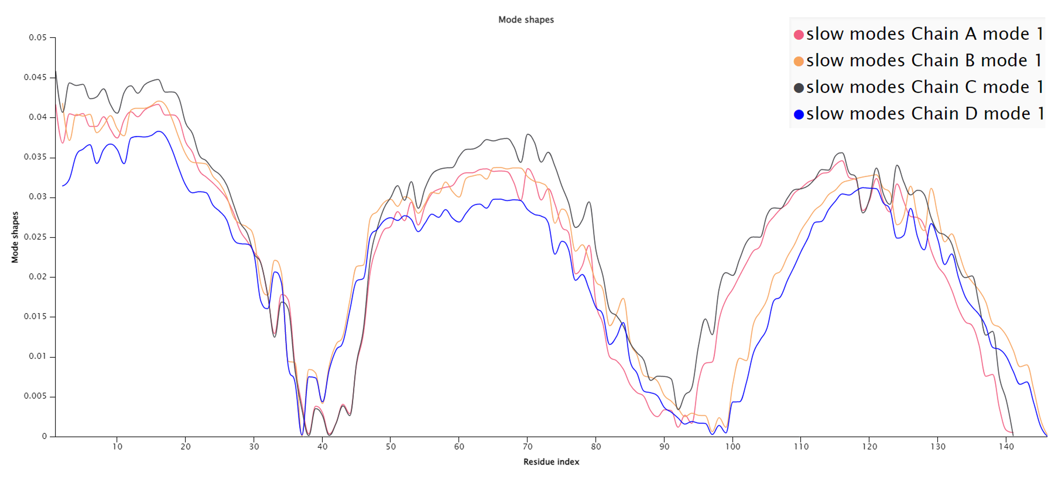
0.5
Hemoglobin slowest mode
0.4
0.3
Mode shape
0.2
0.1
0
10
20
30
40
50
60
70
80
90
100
110
120
130
140
Amino acid index
Notes:
hemoglobin_slowest_mode_edited

Slide 45
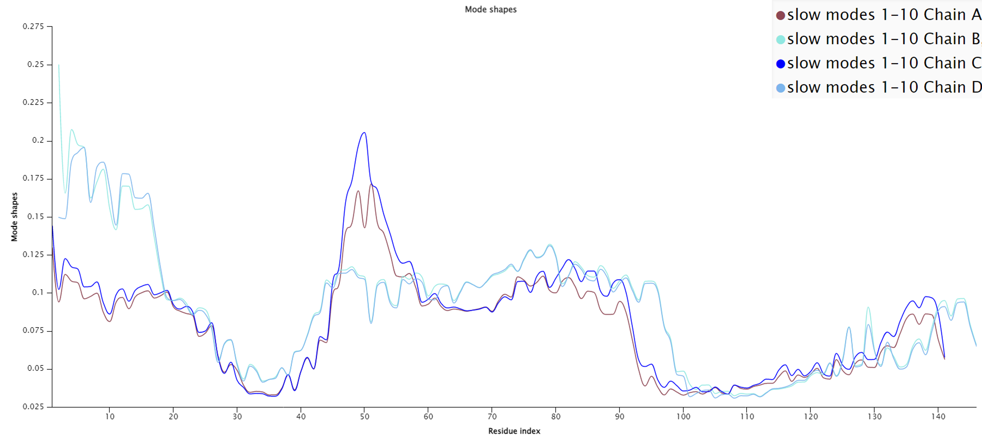
0.5
Hemoglobin ten slowest modes average
0.4
0.3
Mode shape
0.2
0.1
0
10
20
30
40
50
60
70
80
90
100
110
120
130
140
Amino acid index
Notes:
hemoglobin_mode_shape_avg_edited

Slide 46
SARS-CoV-2 Chimeric RBD with ACE2 |  |  |  |  | SARS-CoV RBD with ACE2
 | Elec. | vdW | Total |  |  | Elec. | vdW | Total
A to E | -164.67 | -73.83 | -238.49 |  | A to E | -95.27 | -55.55 | -150.82
B to F | -149.89 | -70.55 | -220.44 |  | B to F | -130.52 | -59.69 | -190.21
482 to 486 | -7.12 | -5.21 | -12.33 |  | 468 to 472 | -0.40 | -1.82 | -2.22
486 | -2.66 | -4.25 | -6.91 |  | 472 | -0.03 | -1.49 | -1.53
455 | 5.55 | -4.43 | 1.13 |  | 442 | 2.77 | -4.08 | -1.31
ACE 31 & 35 | -32.71 | -9.93 | -42.64 |  | ACE 31 & 35 | 5.65 | -4.31 | 1.34
501 | -9.14 | -6.36 | -15.51 |  | 487 | 3.99 | -5.70 | -1.71
ACE 38 & 353 | -13.01 | -8.31 | -21.32 |  | ACE 38 & 353 | -19.90 | -9.51 | -29.41

Slide 47
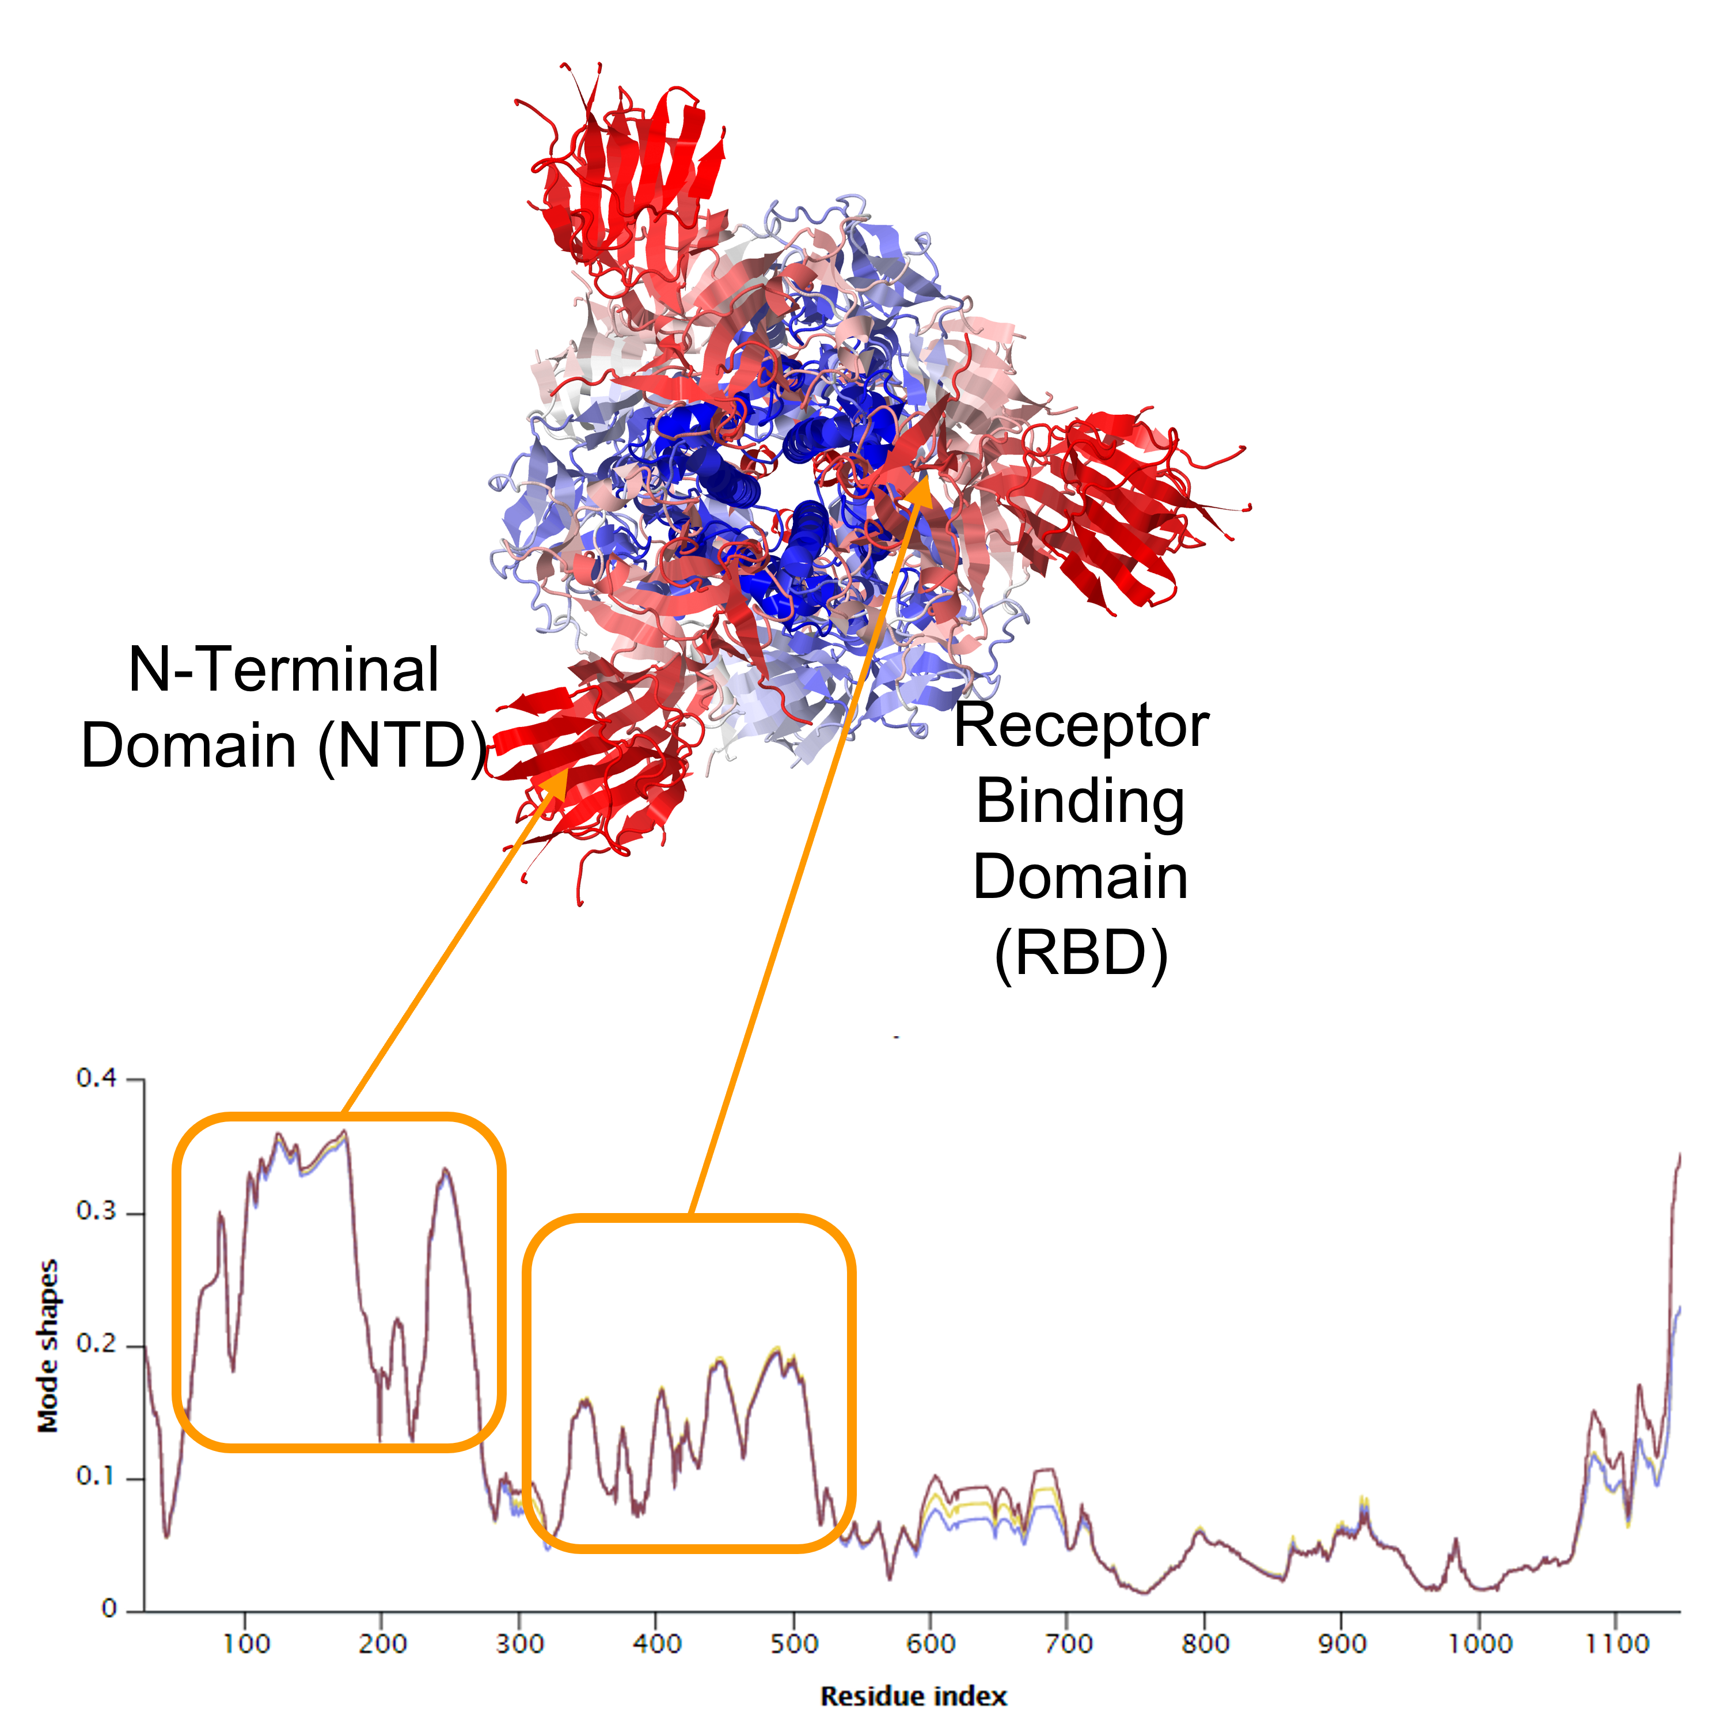
0.4
0.3
Mode shape
0.2
0.1
0
100
200
300
400
500
600
700
800
900
1000
Amino acid index
Notes:
spike_slowmode_SARS-CoV-2_edited

Slide 48
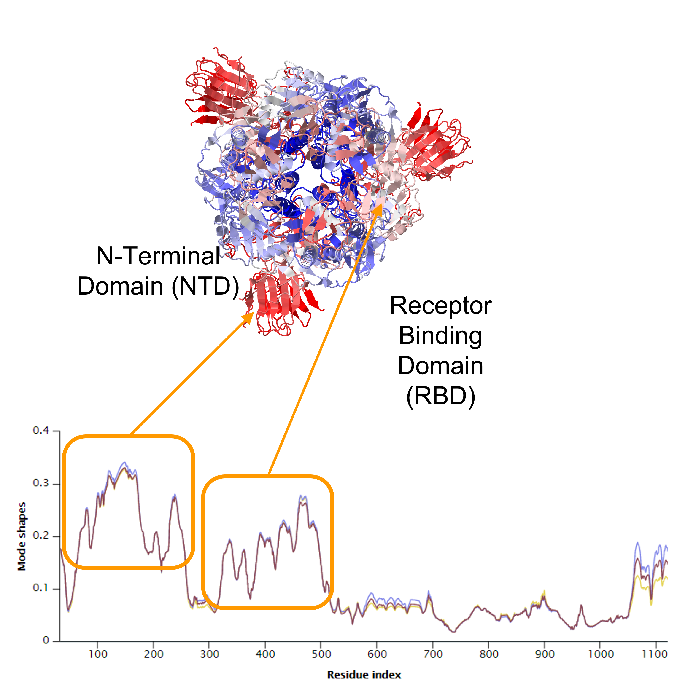
0.4
0.3
Mode shape
0.2
0.1
0
100
200
300
400
500
600
700
800
900
1000
Amino acid index
Notes:
spike_slowmode_SARS-CoV_edited

Slide 49
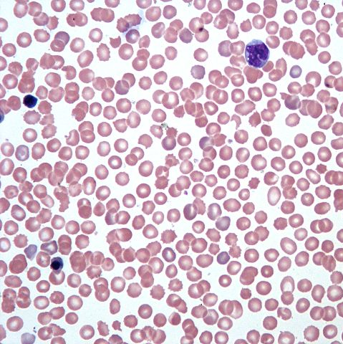
3 mm
0.25 mm
Notes:
hemocytometer

Slide 50
Notes:
knn_neighborhood

Slide 51
Notes:
knn_neighborhood_k=1

Slide 52
Notes:
knn_neighborhood_k=4

Slide 53
Notes:
three_similar_shapes_unaligned

Slide 54
Notes:
three_similar_shapes_aligned

Slide 55
Notes:
inscribed_circle

Slide 56
Notes:
inscribed_sphere

Slide 57
Notes:
inscribed_circle_and_sphere

Slide 60
Notes:
residuals_y_coordinates

Slide 61
Notes:
residuals_x_coordinates

Slide 62
Notes:
residuals_projections

Slide 63
Notes:
three_dimensional_pca

Slide 64
Notes:
three_dimensional_pca_plane

Slide 65
Test condition
Positive
Negative
True Positive | False Negative
False Positive | True Negative
Positive
Actual condition
Negative
Notes:
medical_test_confusion_matrix

Slide 66
Test condition
Positive
Negative
1,000 | 500
2,000 | 198,000
Positive
Actual condition
Negative
Notes:
medical_test_confusion_matrix_hypothetical

Slide 67
x₁
Input
Variables
Output
2
1 if x₁+x₂ ≥ 2
x₂
Threshold
Notes:
MP_neuron

Slide 68
x₁
w₁
Input
Variables
Output
b
w₂
1 if w₁x₁+w₂x₂ ≥ b
x₂
Threshold
Notes:
perceptron

Slide 69
x₁
w₁
Output
Input
Variables
b
f(w₁ · x₁ + w₂ · x₂ – b)
x₂
w₂
Notes:
activation_function

Slide 70
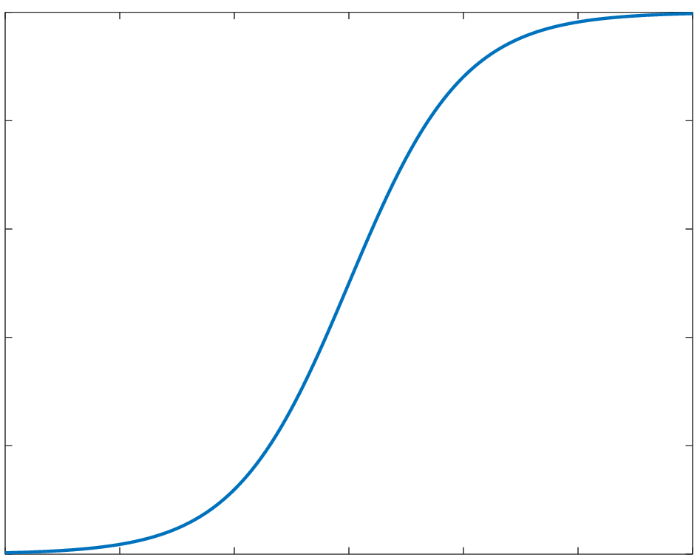
1
0.8
0.6
f(x) = 1/(1+e^{–x} )
0.4
0.2
0
-6
-4
-2
0
2
4
6
x
Notes:
logistic_function

Slide 71
1
Output
Notes:
rectifier

Slide 72
x₁
1 if granulocyte
f
...
...
1 if lymphocyte
f
...
1 if monocyte
...
f
x_{n}
Hidden Neurons
Output
Input
Notes:
neural_network_wbc

Slide 73
x₁
1 if granulocyte
b₁
...
...
1 if lymphocyte
b₂
...
1 if monocyte
...
b₃
x_{n}
Hidden Neurons
Output
Input
Notes:
neural_network_wbc

Slide 74
Notes:
curse_of_dimensionality_two_irises

